Slide 1



AUDIENCE
using social media to find it,
engage it, grow it.
presented by Kay O’Donnell
North Central College, Naperville, Ill.

Slide 2
Facebook is Eating the World
Emily Bell, Columbia Journalism Review, 2016
  “Social media hasn’t just swallowed journalism, it has swallowed everything. It has swallowed political campaigns, banking systems, personal histories, the leisure industry, retail, even government and security. The phone in our pocket is our portal to the world.”

Slide 3
Emily Bell, CJR 2016
“With billions of users and hundreds of thousands of articles, pictures, and videos arriving online everyday, social platforms have to employ algorithms to try and sort through the important and recent and popular and decide who ought to see what. And we have no option but to trust them to do this.”

Slide 4
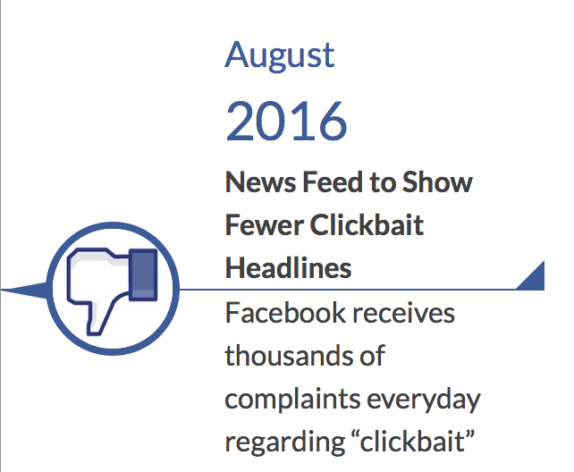
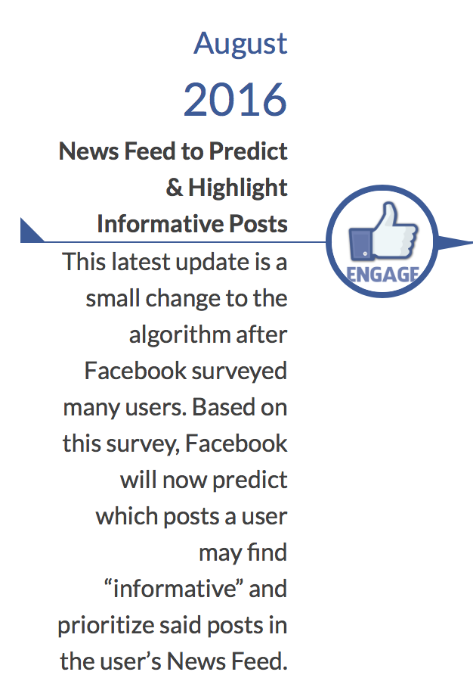
Let’s look at those FB algorithms

Slide 5
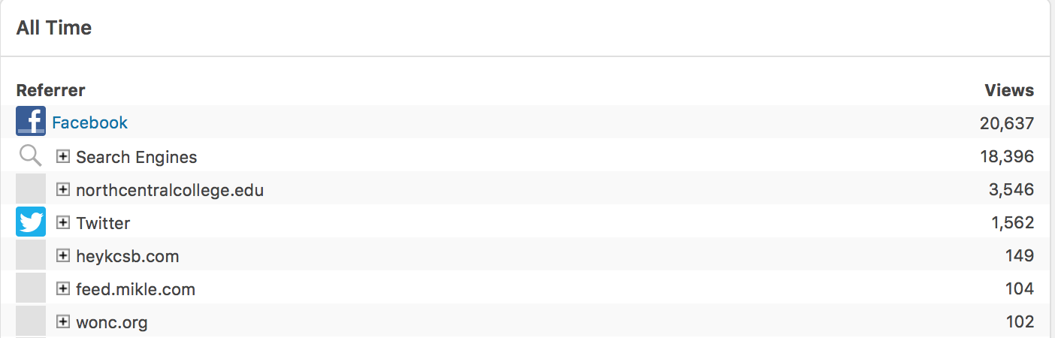
FB still provides the strongest link

Slide 6
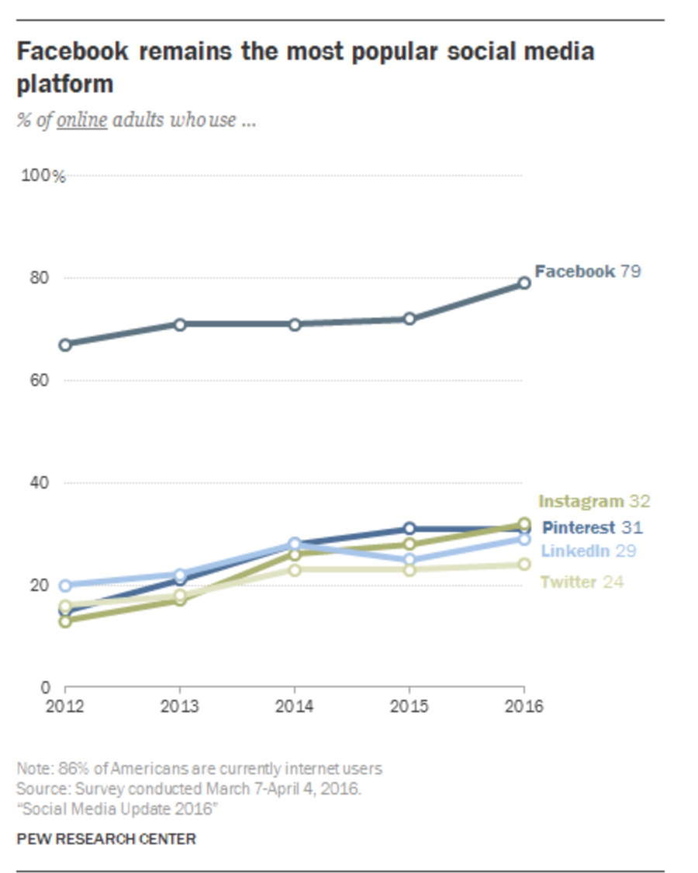
Why we talk about FB ...

Slide 7
What’s the best fit? The Big 3
Facebook Page – best suited for organizations, clubs, businesses; largest potential payback, but “boosting” is essential to building audience
Instagram – good fit for capturing younger audience; can be easier (than the other 2) to build a following; photo quality is crucial; hashtags, hashtags, hashtags.
Twitter – best for live tweeting events, jumping in on bigger conversations/trending topics; hashtags.

Slide 8
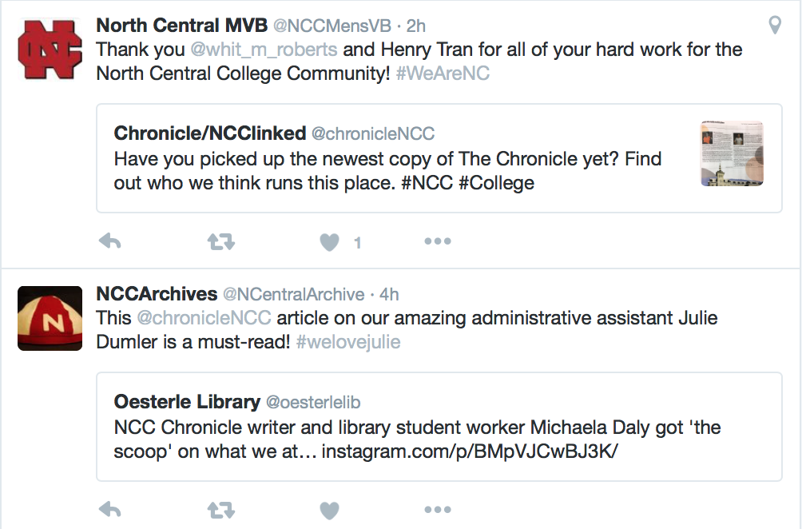
Connecting with audience

Slide 9

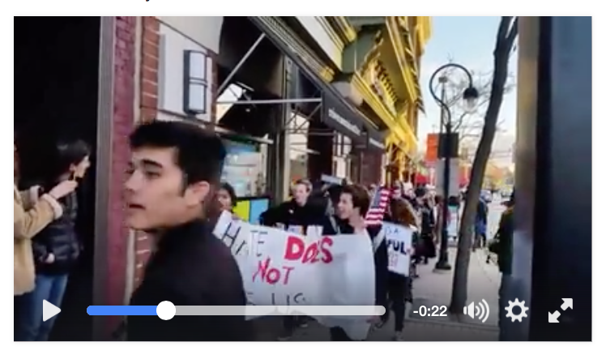
Will Federman’s tips …
Craft social language
Develop audience strategy
Develop SEO strategy
Assign stories
Talk about trending
Look at analytics
VIDEO STILL RULES
(embed directly, don’t link)
*Federman is managing editor of The Tylt, ex-audience engagement editor at Fortune Magazine.

Slide 10
Reality bites: Will’s tips translated
Language is important – be concise, engaging, witty even (but match tone to content). Find your voice and be consistent.
Audience is everything – cultivate loyal followers by giving them the unique content you can offer. Think hyperlocal.
Tell your story – use images, videos and text to share your message; avoid redundancy across platforms.
Key words and hashtags – pay attention to these as they are vital to pushing your content to the right audience.
Look at what works – watch your analytics and respond, retool, revise.

Slide 11
Some of the tricks of the trade
To grow followers:
  Follow others connected to your mission/focus/community
  Engage with the people you follow
  Look for universal hashtags (especially on Instagram and Twitter); no limit to Instagram hashtag use
  Set a budget and “boost” content you believe will connect with your audience
  PATIENCE, TENACITY (and maybe a touch of obsession)
  Celebrate the little victories
  Never underestimate your impact (numbers don’t tell the whole story)

Slide 12
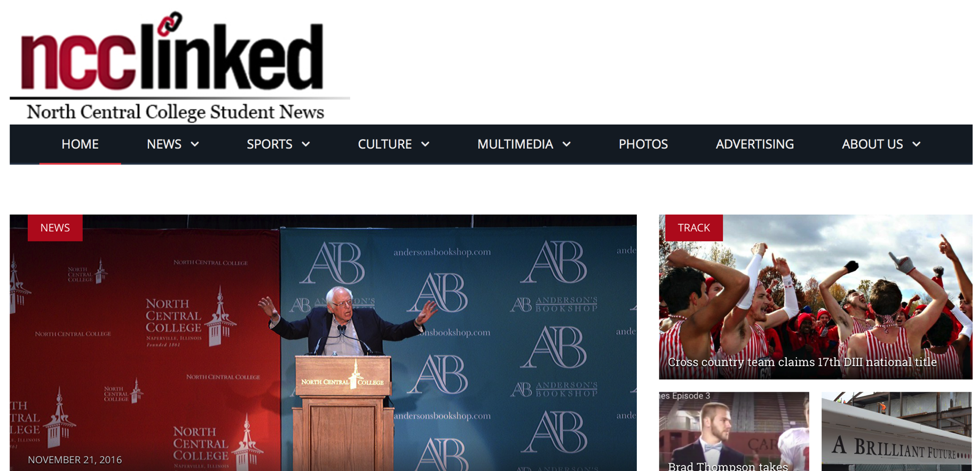
CASE STUDY: NCClinked.com

Slide 13
NCClinked.com
The website is the product
Maintains 3 primary channels (FB, Twitter, Instagram) and 2 secondary (Snapchat, YouTube)
Social media serves two functions:
  drive traffic to the site
  offer original “social-only” content
    content serves to heighten brand

Slide 14
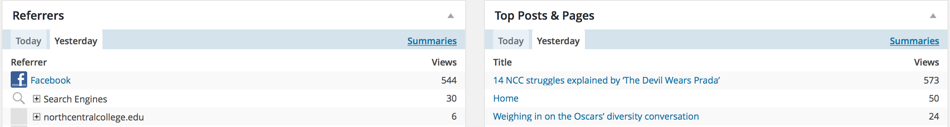
Driving traffic … 24-hour period

Slide 15
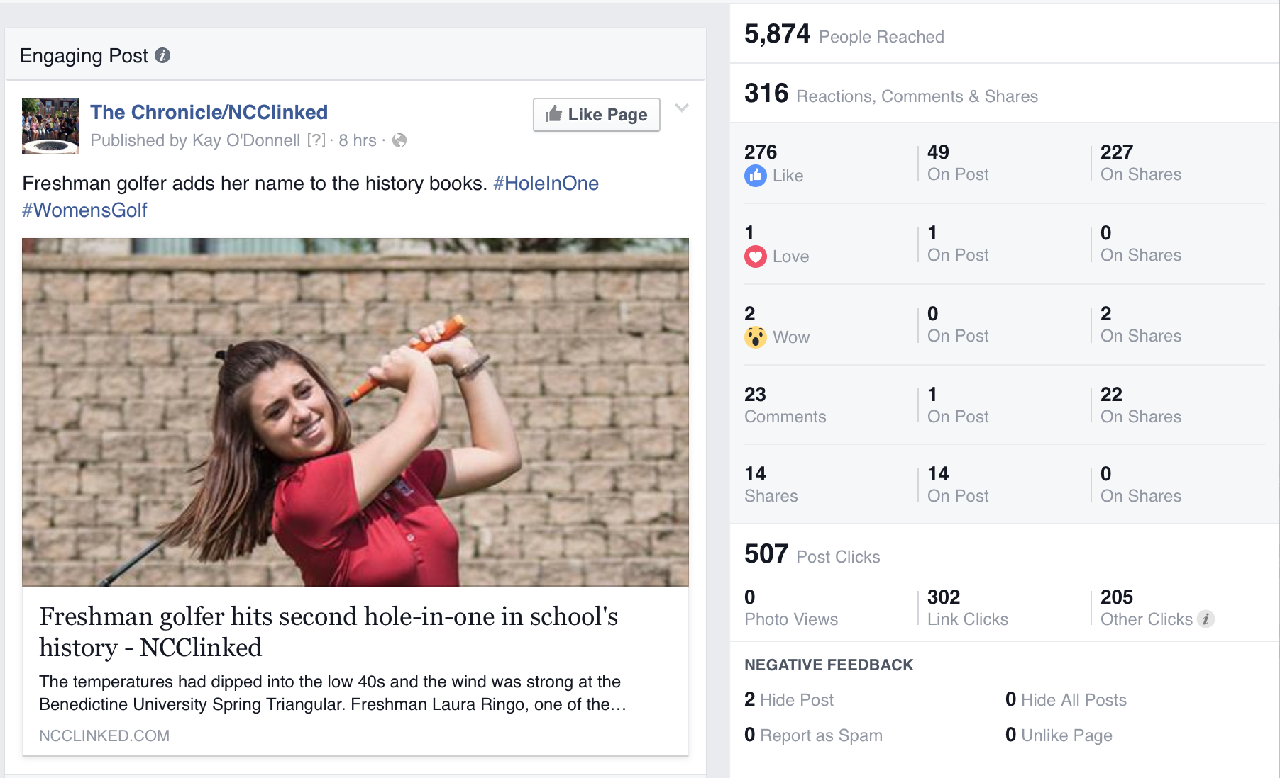
‘Organic’ connection:

Slide 16
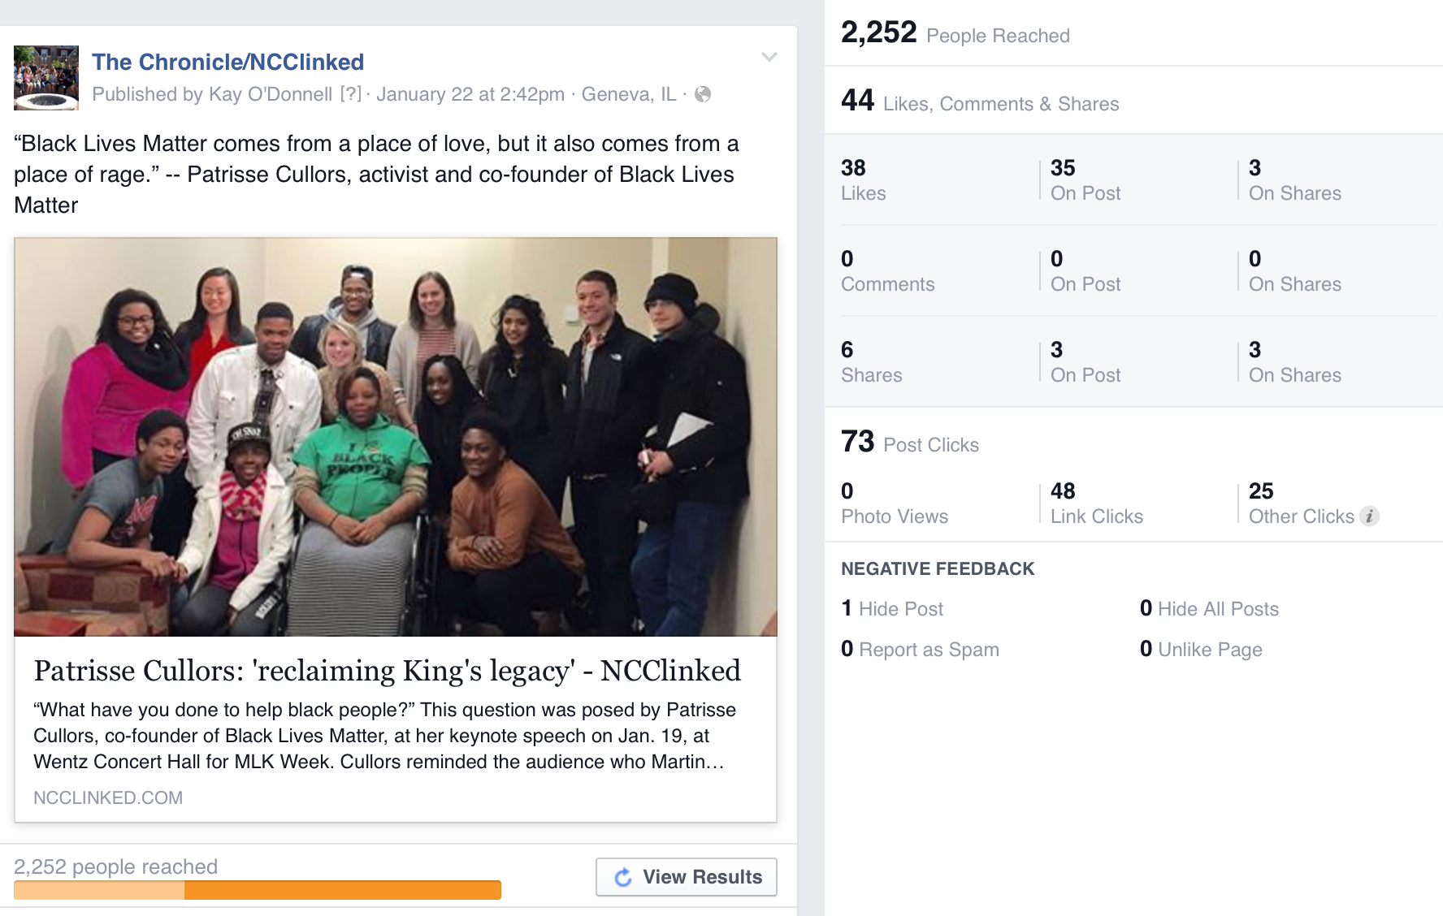
‘Boosted’ connection:

Slide 17
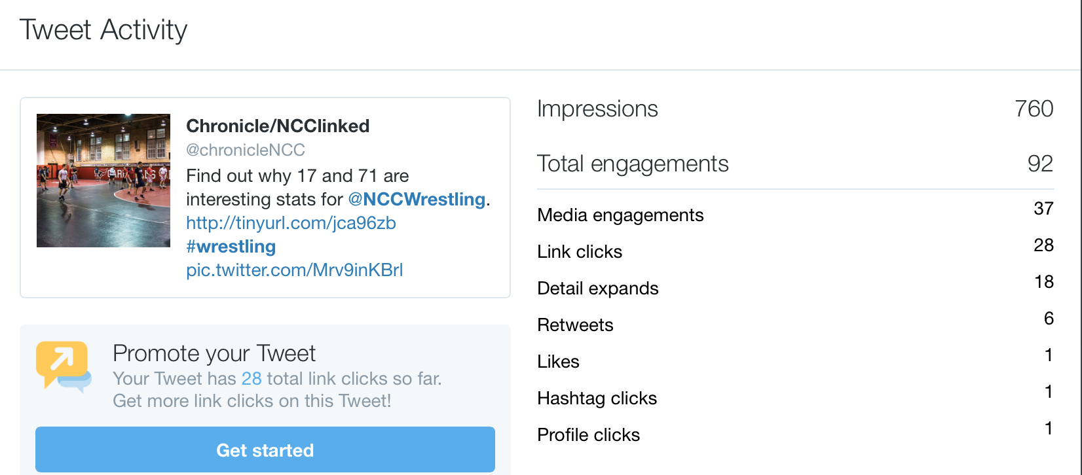
When Twitter works …

Slide 18
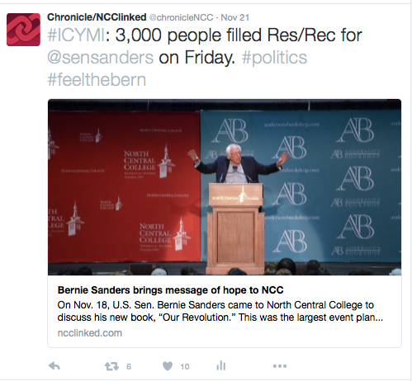
Combination of factors …

Slide 19
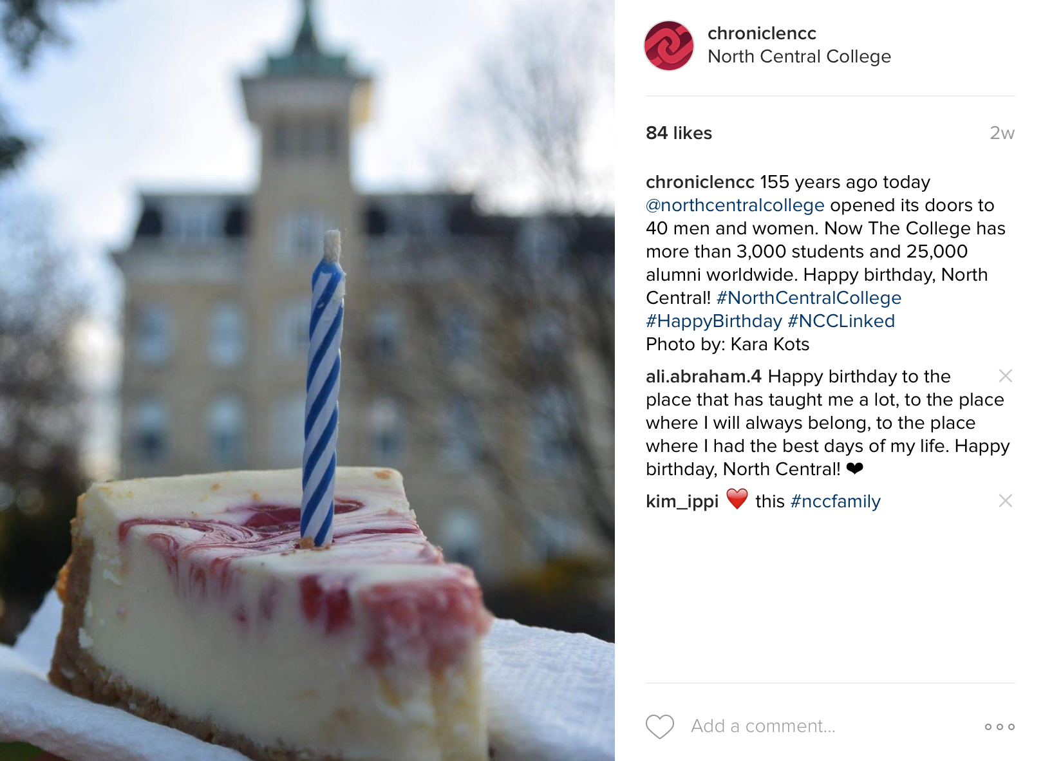
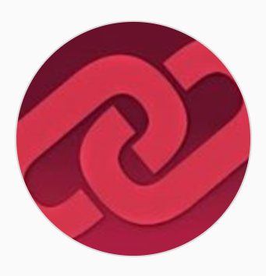
Instagram: the real storyteller

Slide 20
Seven days in November: the Big 3
NCClinked activity from Nov. 7-Nov. 13 (REACH ONLY):
5,023 on Instagram (impressions)
20,900 on Twitter (impressions)
22,605 on Facebook (reach)
48,528

Slide 21
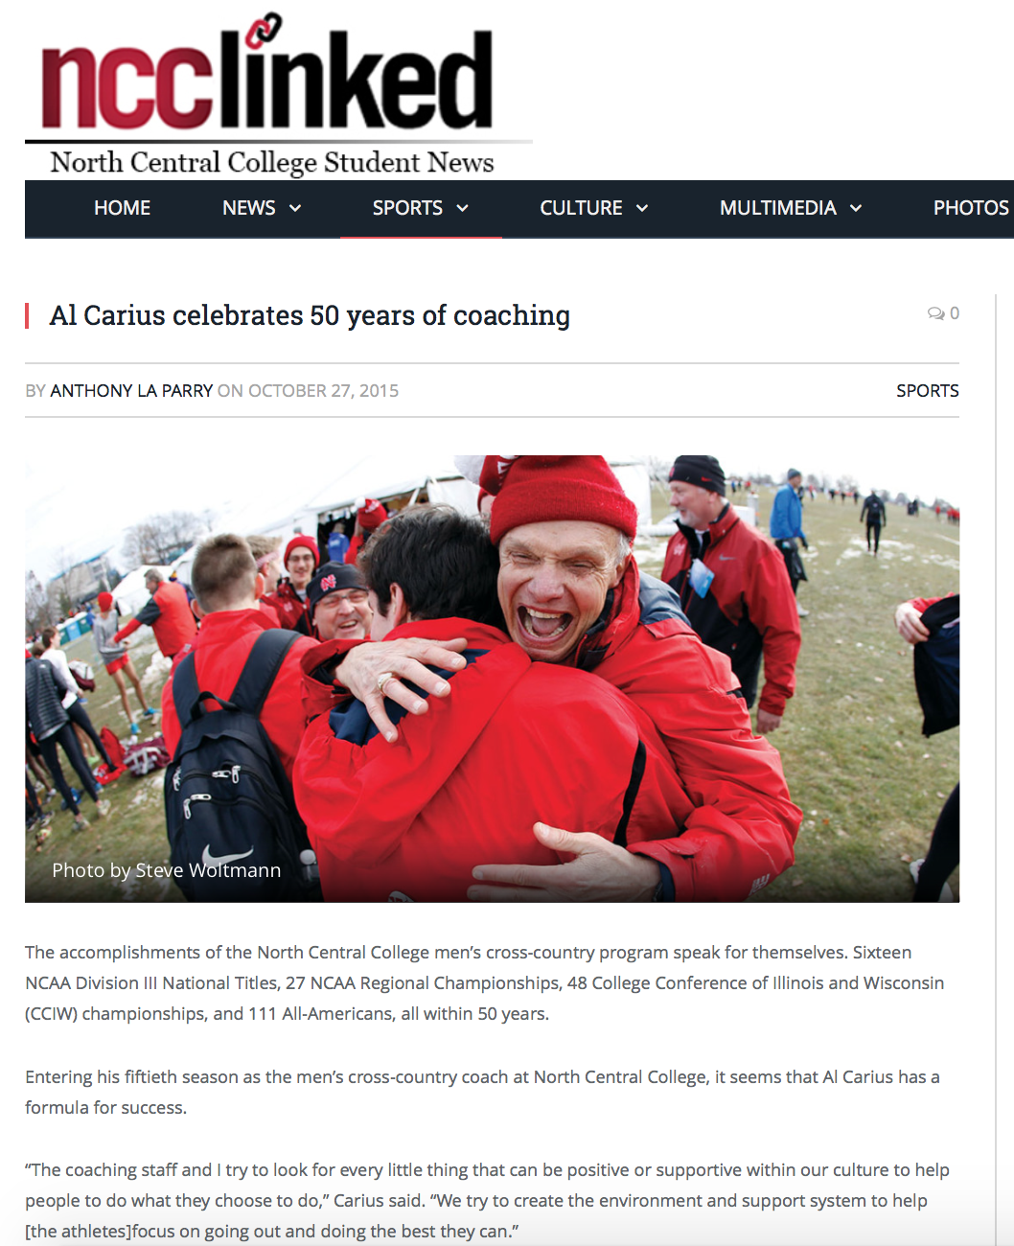
THE POWER OF ONE STORY:

Slide 22
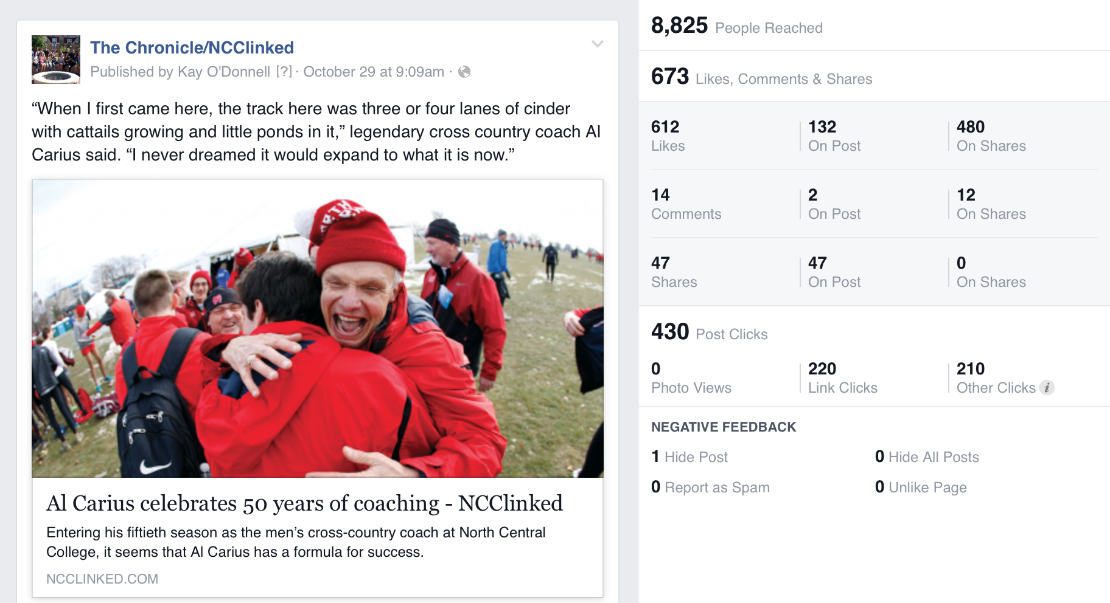
Data tell stories: lessons?

Slide 23
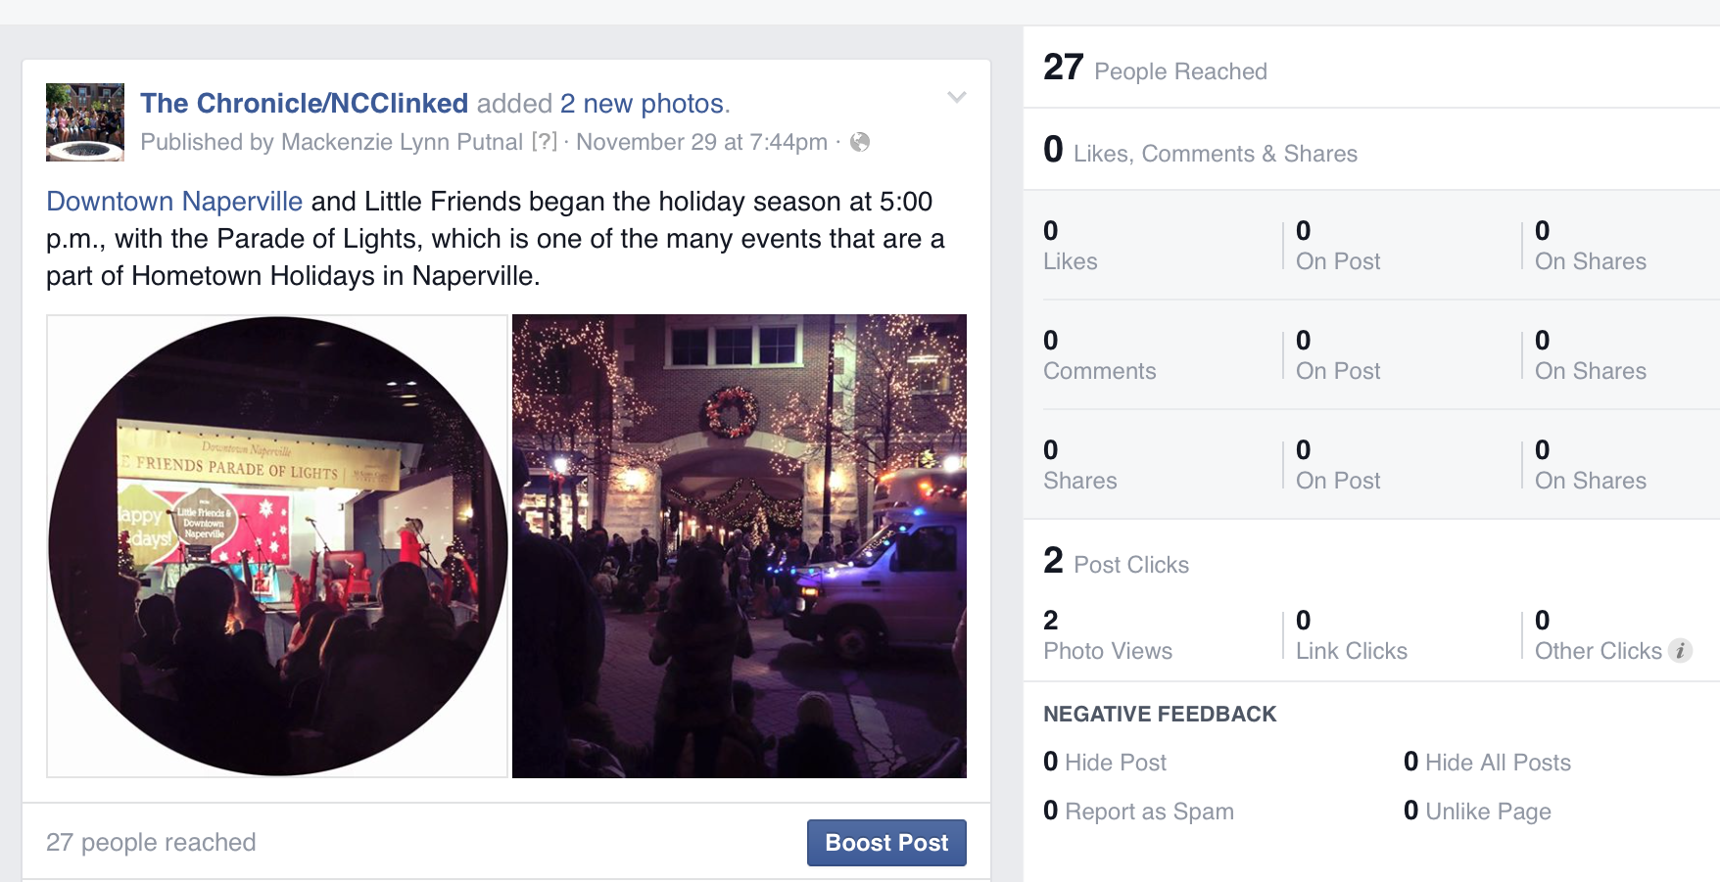
Data tell stories: lessons?

